Slide 1
Introduction To Programming

Slide 2
Content
Structure

Slide 3
Structure
Structures (also called structs) are a way to group several related variables into one place. Each variable in the structure is known as a member of the structure.
To create a structure, use the struct keyword and declare each of its members inside curly braces.
After the declaration, specify the name of the structure variable

Slide 4
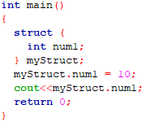
Structure...
Example-
struct {
int num1;
float num2;
} myStruct;
To access members of a structure, use the dot syntax (.)-

Slide 5
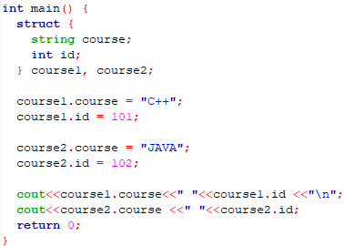
Structure in Multiple Variables

Slide 6
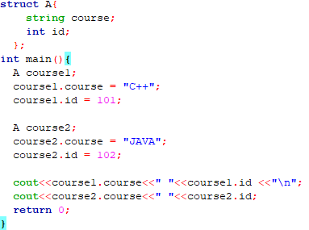
Structure in Multiple Variables…

Slide 7
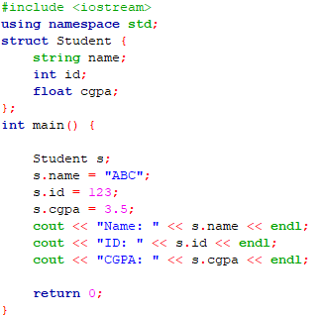
Structure in Multiple Variables…

Slide 8
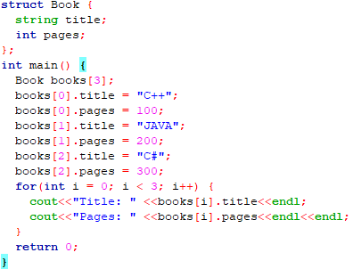
Structure in Multiple Variables…

Slide 9
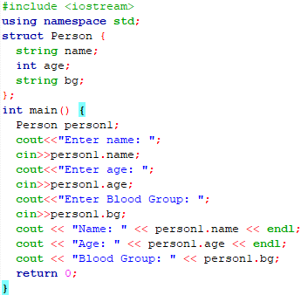
Structure in Multiple Variables…

